Slide 1

Bot Busters

Slide 2
Big question:
How to identify bots in WoC?
Lots of reasons why useful:
Potentially biased statistics of WoC authors
Census of bots / automation practices
Human - bot interaction research
...

Slide 3
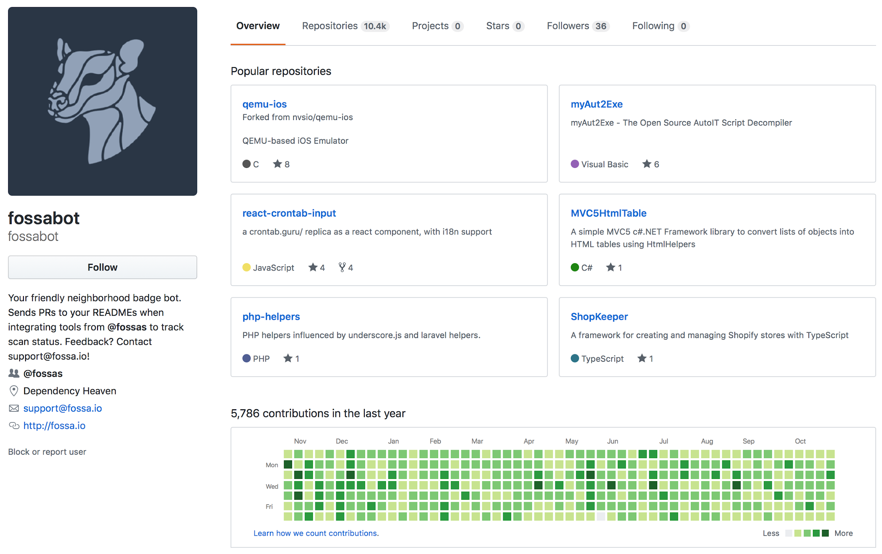

Slide 4
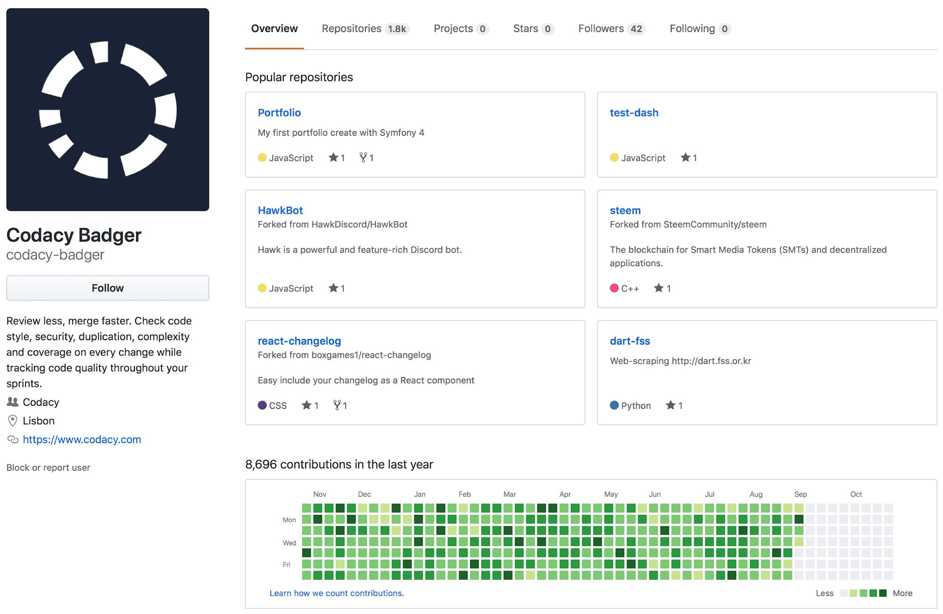

Slide 5
Weekend goal:
Explore signals to identify bots
Commit messages
Time Stamp of the commit
Files touched by the bot authors
Type of files
Number of files
Number of repos to which the author opens Issues, PRs, or commits to
The name or bio of author
Maybe the profile picture of the authors

Slide 6
Collect some
ground truth data

Slide 7
Crawled WoC for commit authors with the term ‘bot’ (~12k total)
*{Helper Bot <h3lperb0t@gmail.com>
@dhis2-bot <ci@dhis2.org>
ACG Build Bot (123D-ACG-Hickory_write) <Dinu.Bunduchi@autodesk.com>
AUR Archive Bot <arch@carsten-teibes.de>
Actor Bot <bot@actor.im>
Agile CI Bot <bot@http://agile-iot.eu/>
Anton Gustafsson Bot <antag99bot@gmail.com>
Authenticator Bot <47196923+authenticator-bot@users.noreply.github.com>
...

Slide 8
Num distinct repos where user opened PRs
GHTorrent ~1 month in May 2019
id | login | num_repos
13810377 | snyk-bot | 4081
11000206 | pyup-bot | 1816
41425235 | regro-cf-autotick-bot | 670
32562891 | codacy-badger | 386
46203337 | hail-ci-test-1 | 329
45952018 | scala-steward | 276
36774104 | fossabot | 246
2167527 | BendingBender | 246
46416266 | hail-hephaestus | 211
46062067 | jenkins-x-bot-test | 161
32280 | olleolleolle | 119
7954512 | GulajavaMinistudio | 107
286192 | arlac77 | 106
210251 | bastelfreak | 105
58018 | aschnell | 103

Slide 9
Num distinct repos where user opened PRs
actors | login | distinct_repos
49699333 | dependabot[bot] | 514832
10810283 | direwolf-github | 64660
27856297 | dependabot-preview[bot] | 23396
39814207 | pull[bot] | 9956
19733683 | snyk-bot | 7896
29139614 | renovate[bot] | 6915
31301654 | imgbot[bot] | 5517
23040076 | greenkeeper[bot] | 3224
7571158 | xmo-odoo | 1916
42819689 | whitesource-bolt-for-github[bot] | 1892
16239342 | pyup-bot | 1861
37936606 | github-learning-lab[bot] | 1398
36490558 | regro-cf-autotick-bot | 1166
43237426 | jenkins-x-bot-test | 833
23717796 | depfu[bot] | 796
43047562 | scala-steward | 711
53303753 | daniel-beck-bot | 571
46447321 | allcontributors[bot] | 346
Interesting: Different results using GitHub Archive
New GitHub feature: apps (dependabot[bot], renovate[bot], ...)
Apps are not users! e.g., will not appear in GHTorrent

Slide 10
Explore new
WoC signals

Slide 11
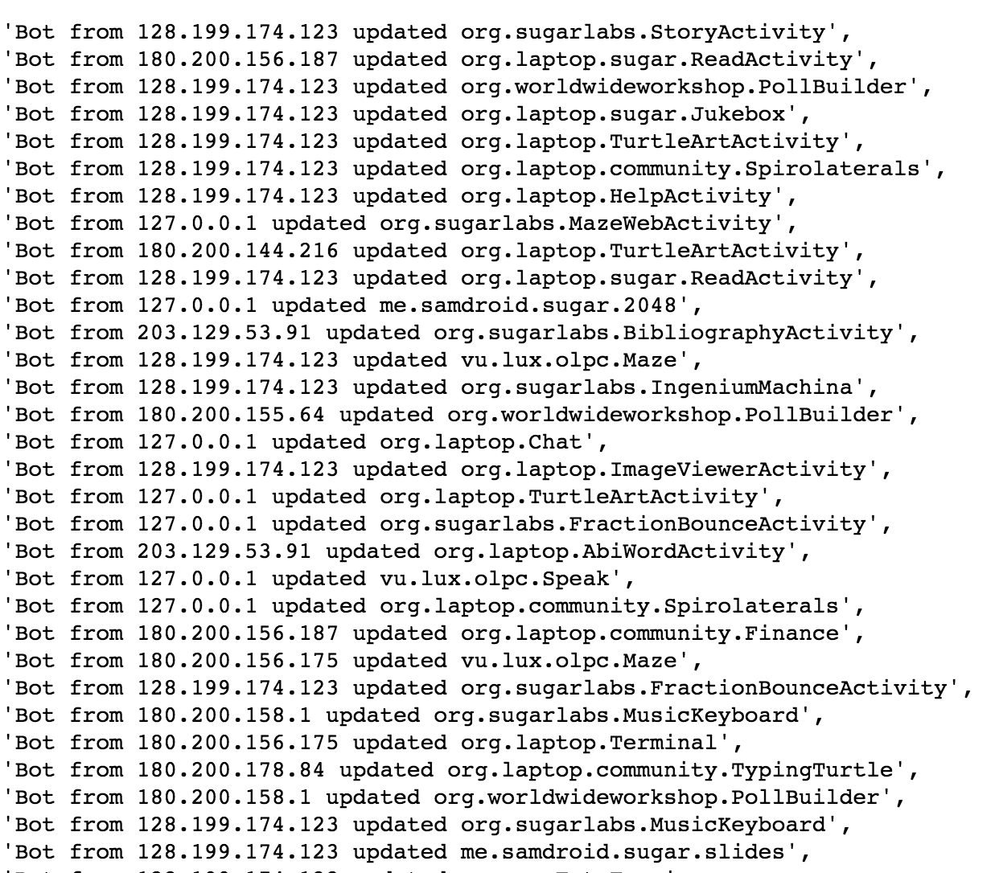
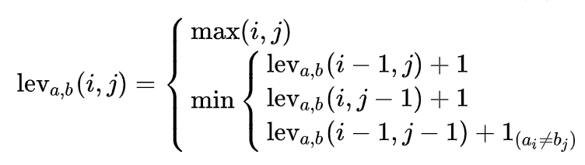
Signal:
Similarity of Commit Messages
Levenshtein Distance:
… or simply the minimum number of character edits required to change one string into another. Very handy for automatically generated strings!

Slide 12
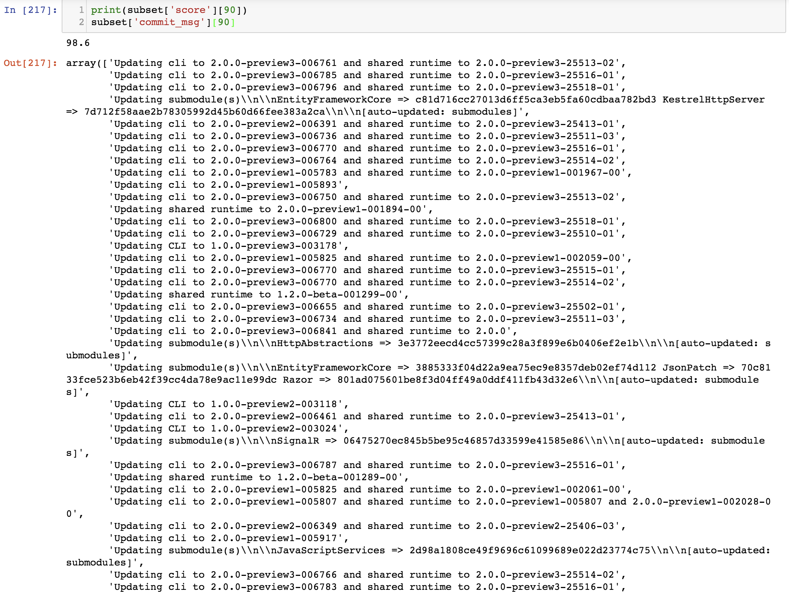
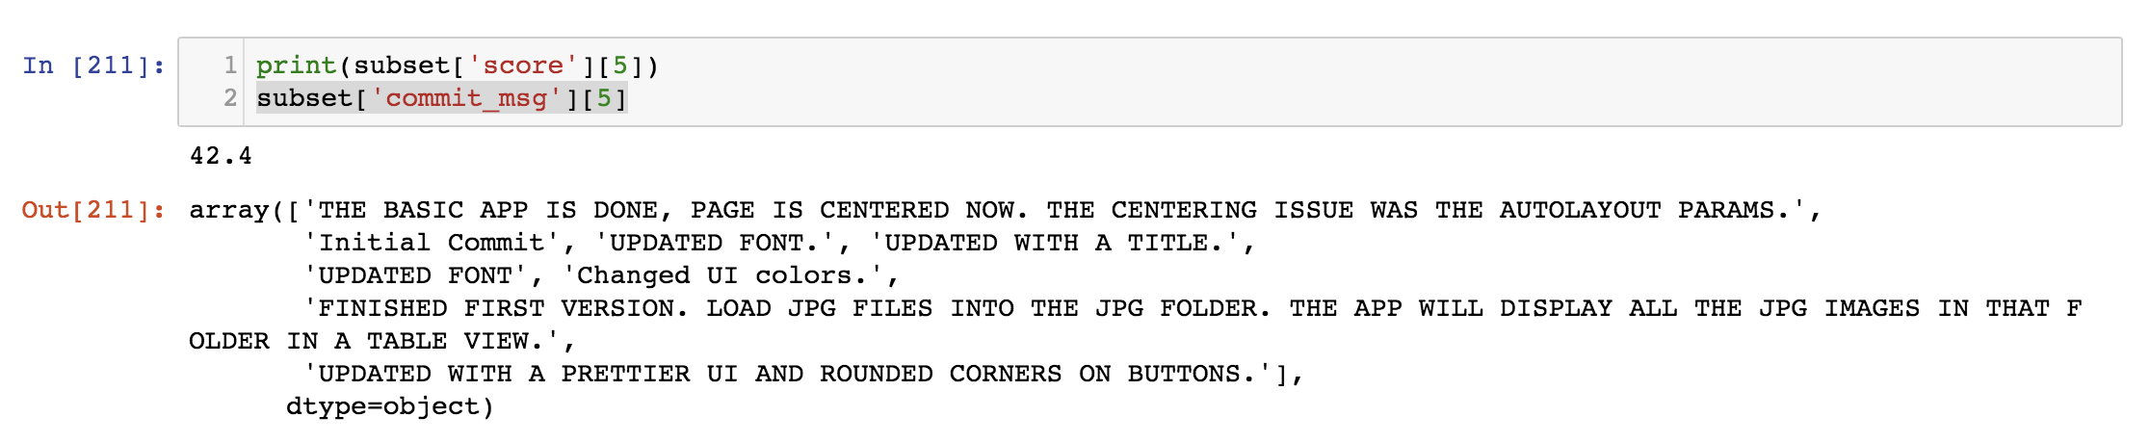
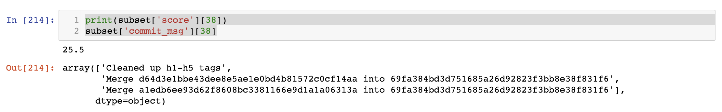
Signal:
Similarity of Commit Messages
Turns out, this naive approach works pretty well…

Slide 13
Commit timestamps
Bots should have:
Either round the clock activity, or
Activity at specific times of the day
Humans should have:
Activity during the day, likely concentrated on the working hours

Slide 14
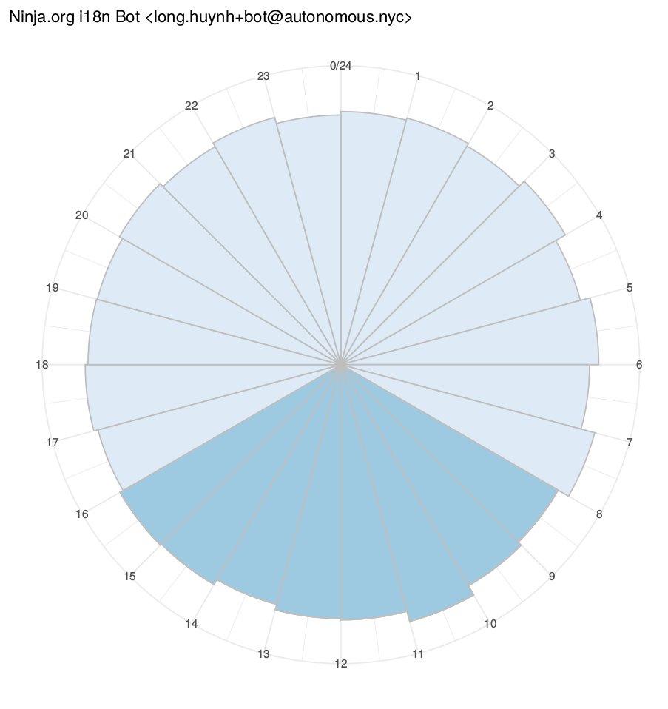
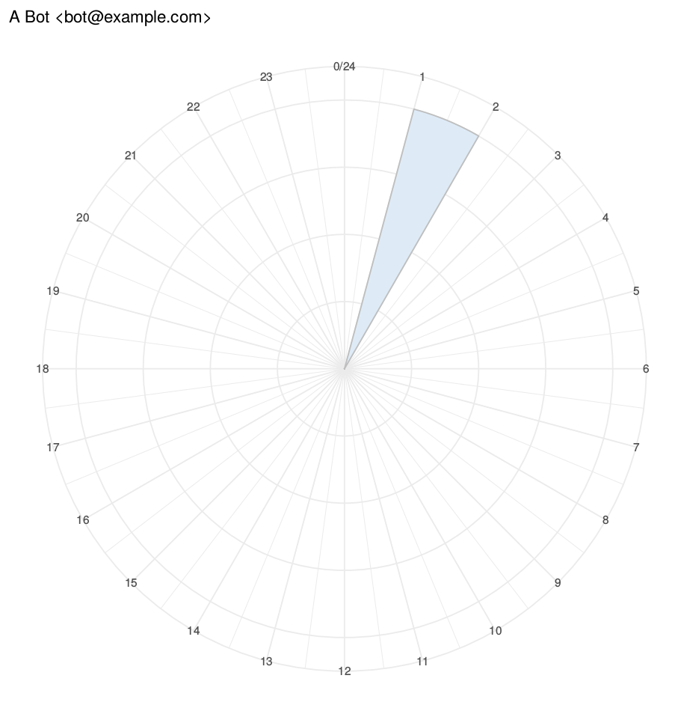
Example of activities of suspected bots

Slide 15
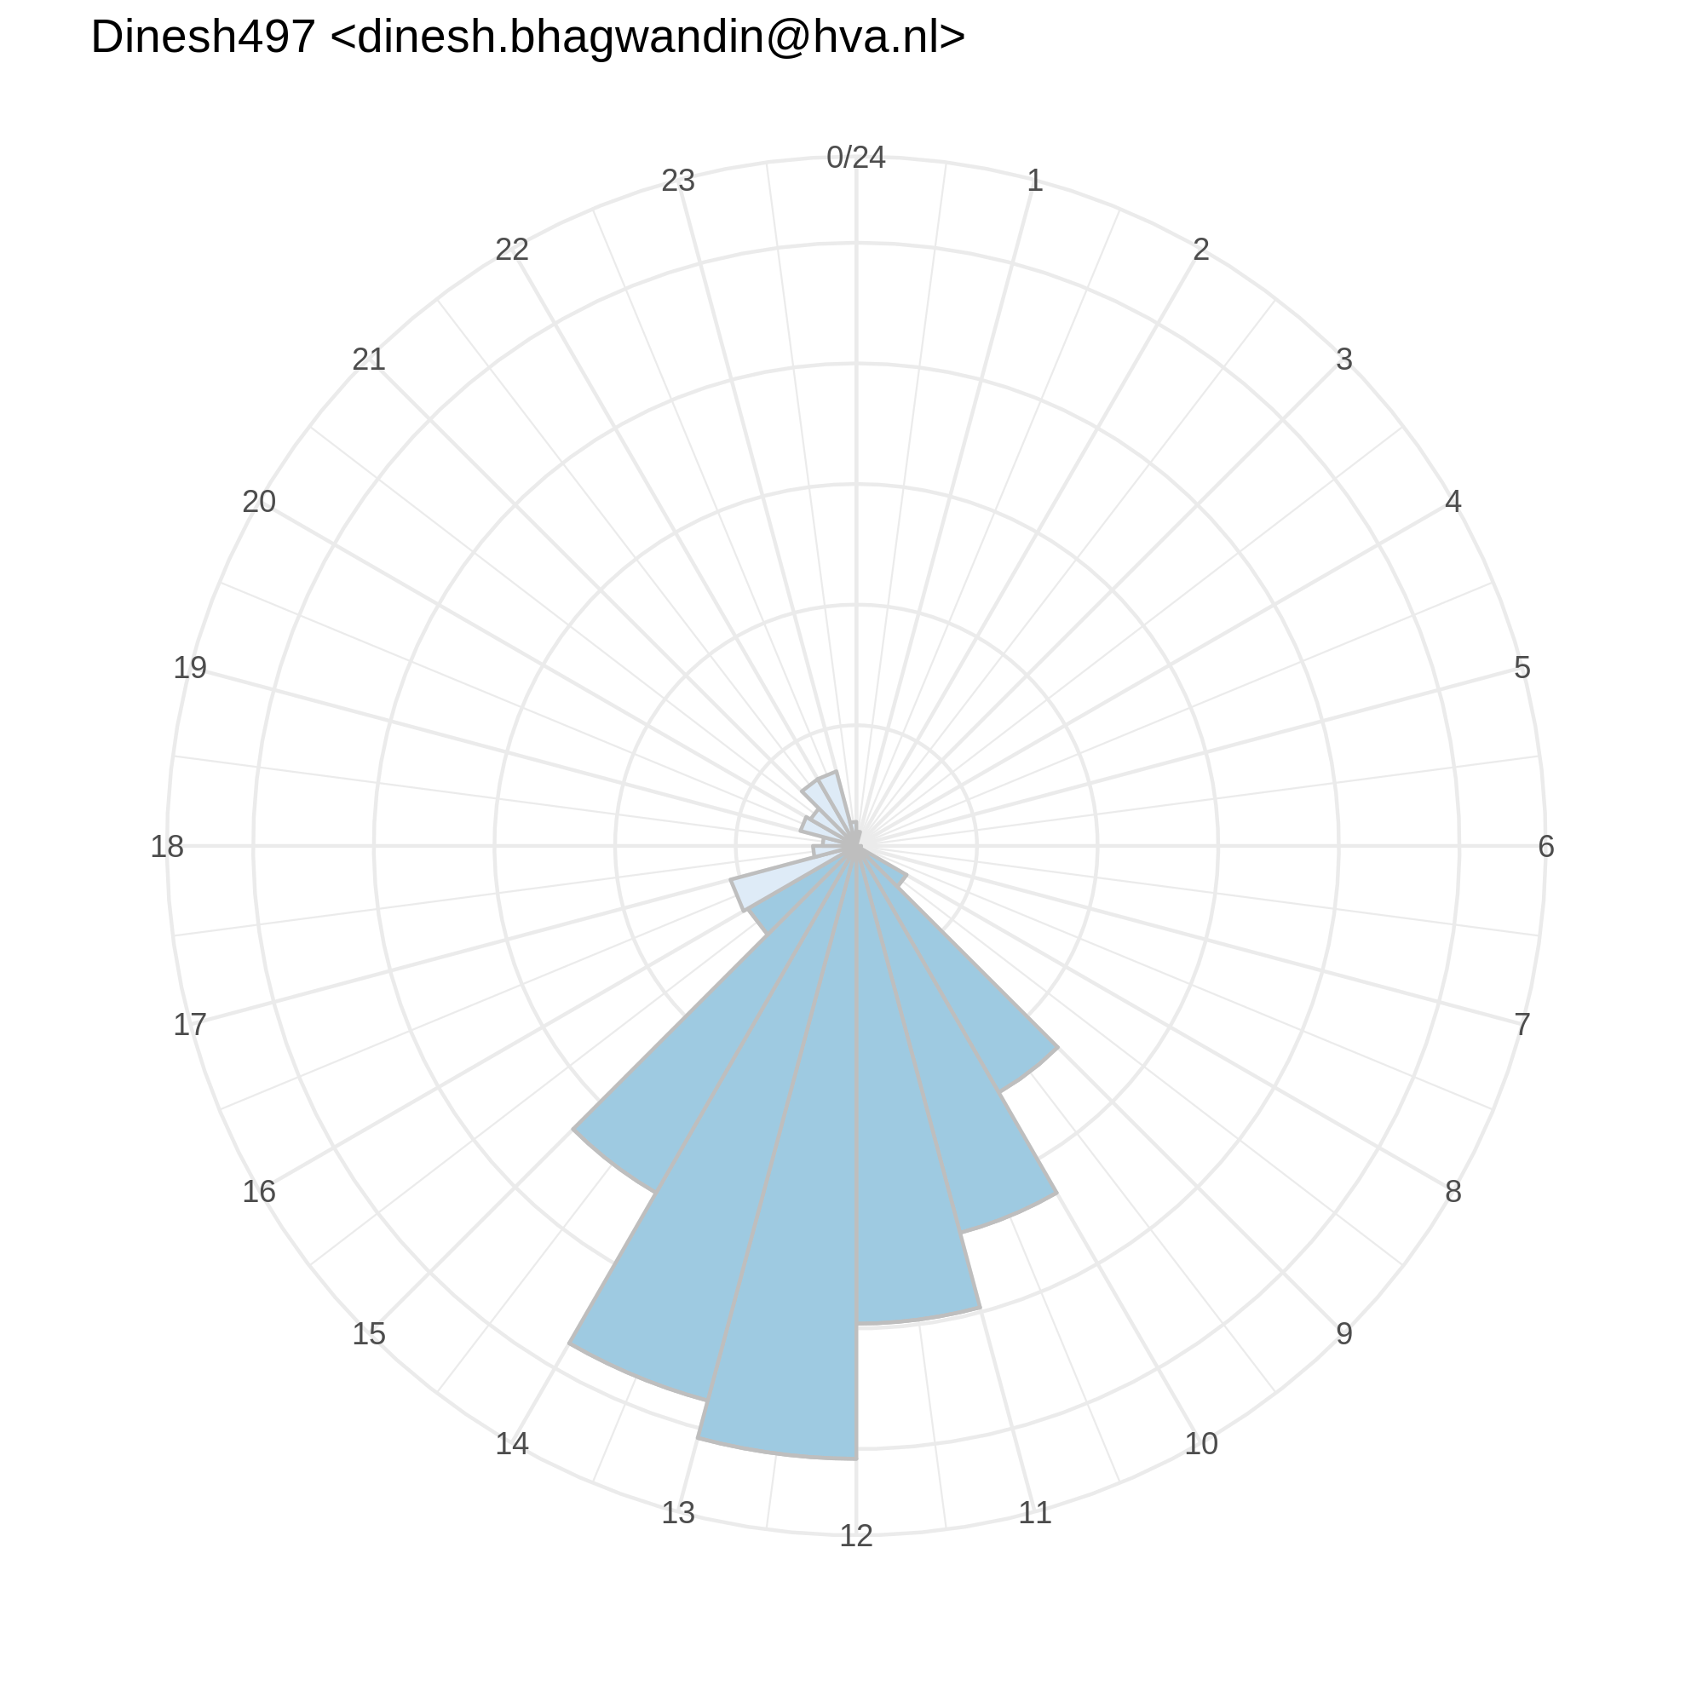
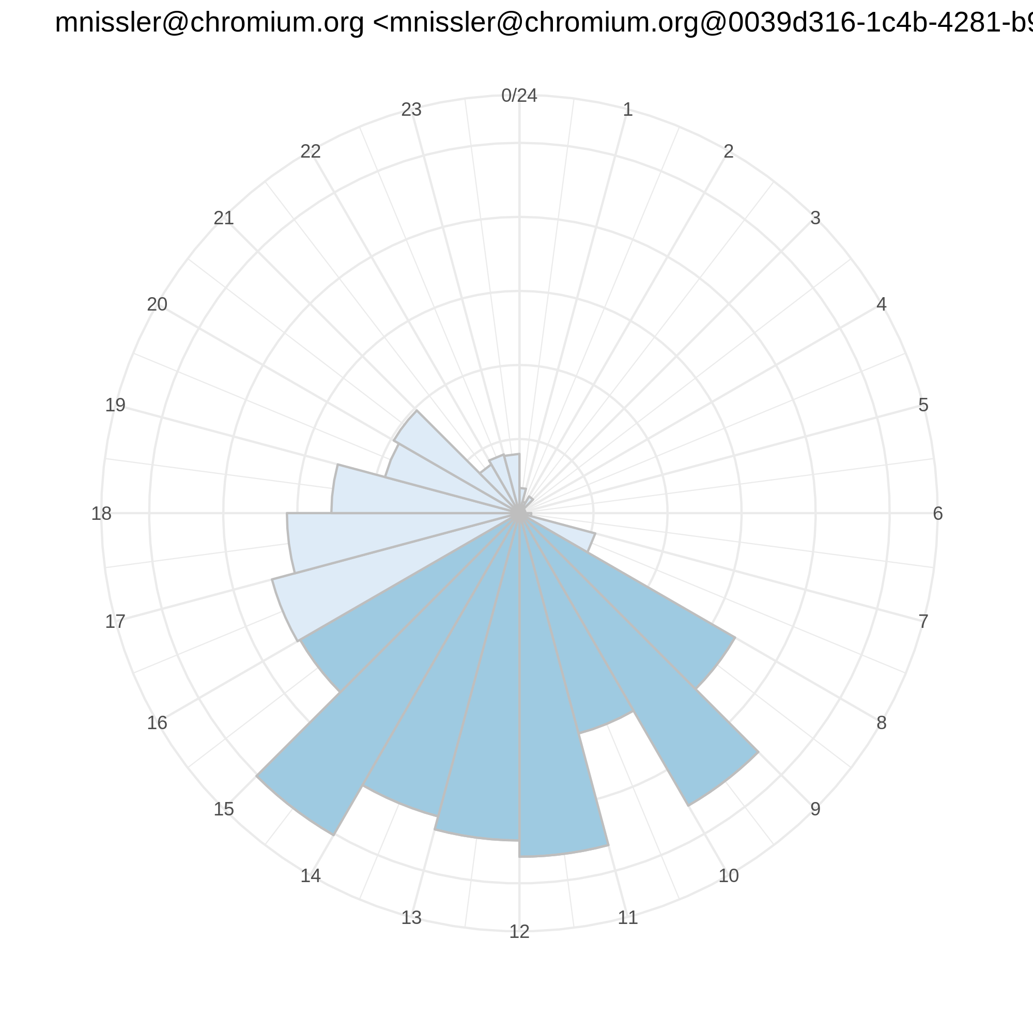
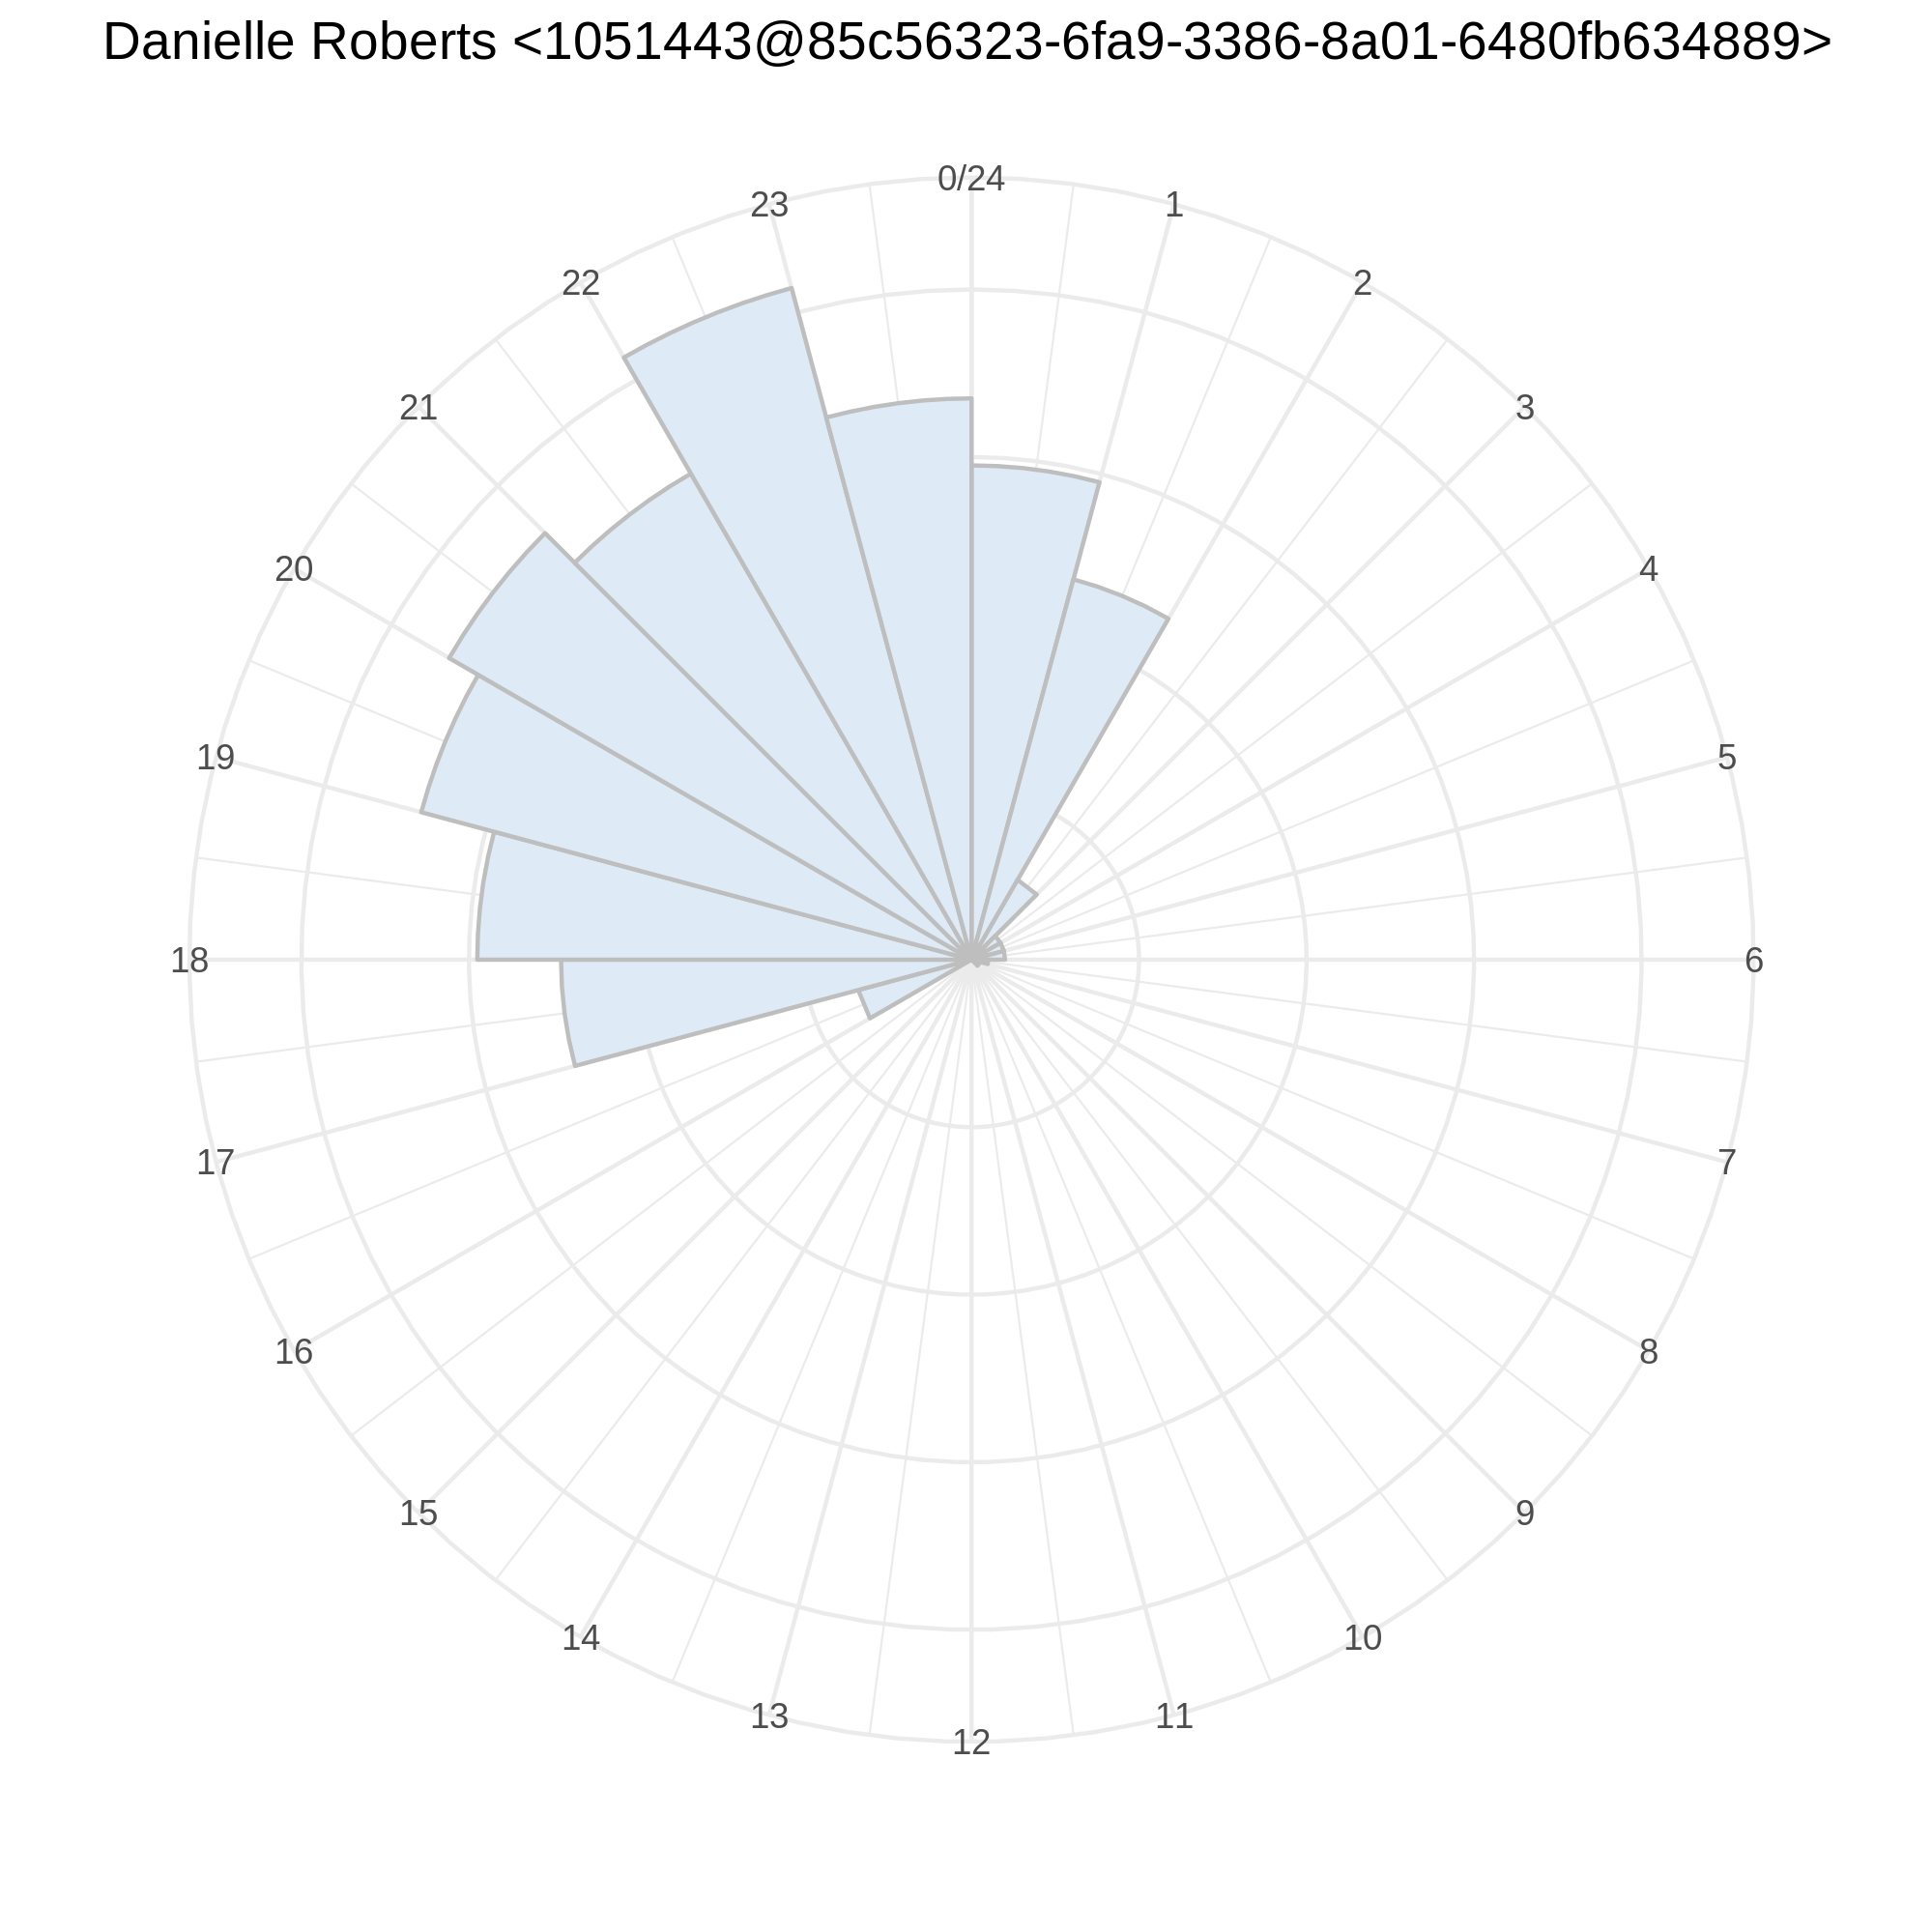
Example of activities of suspected non-bots

Slide 16
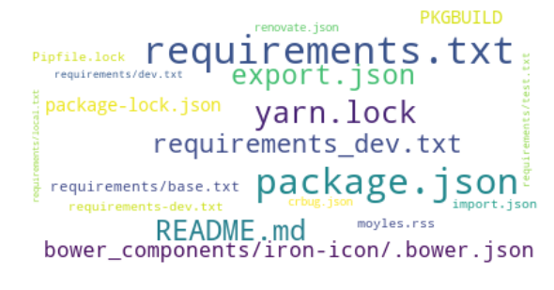
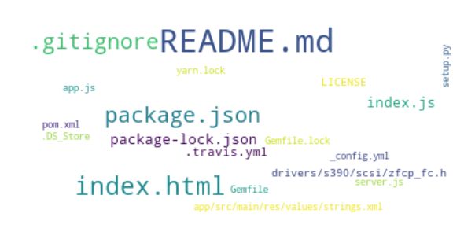
Files Touched by (suspected) bots vs. non-bots
Non-Bots
Bots

Slide 17
Learning the patterns via CNN
Extract the training data
A subset of bot commit message
A subset of human commit messages
Generate embeddings for the selected messages
GloVe: Obtaining vectors representation for words
Train a CNN network on the selected data

Slide 18
